Slide 1
Programming Design
Final Project Presentation
Group N

Slide 2
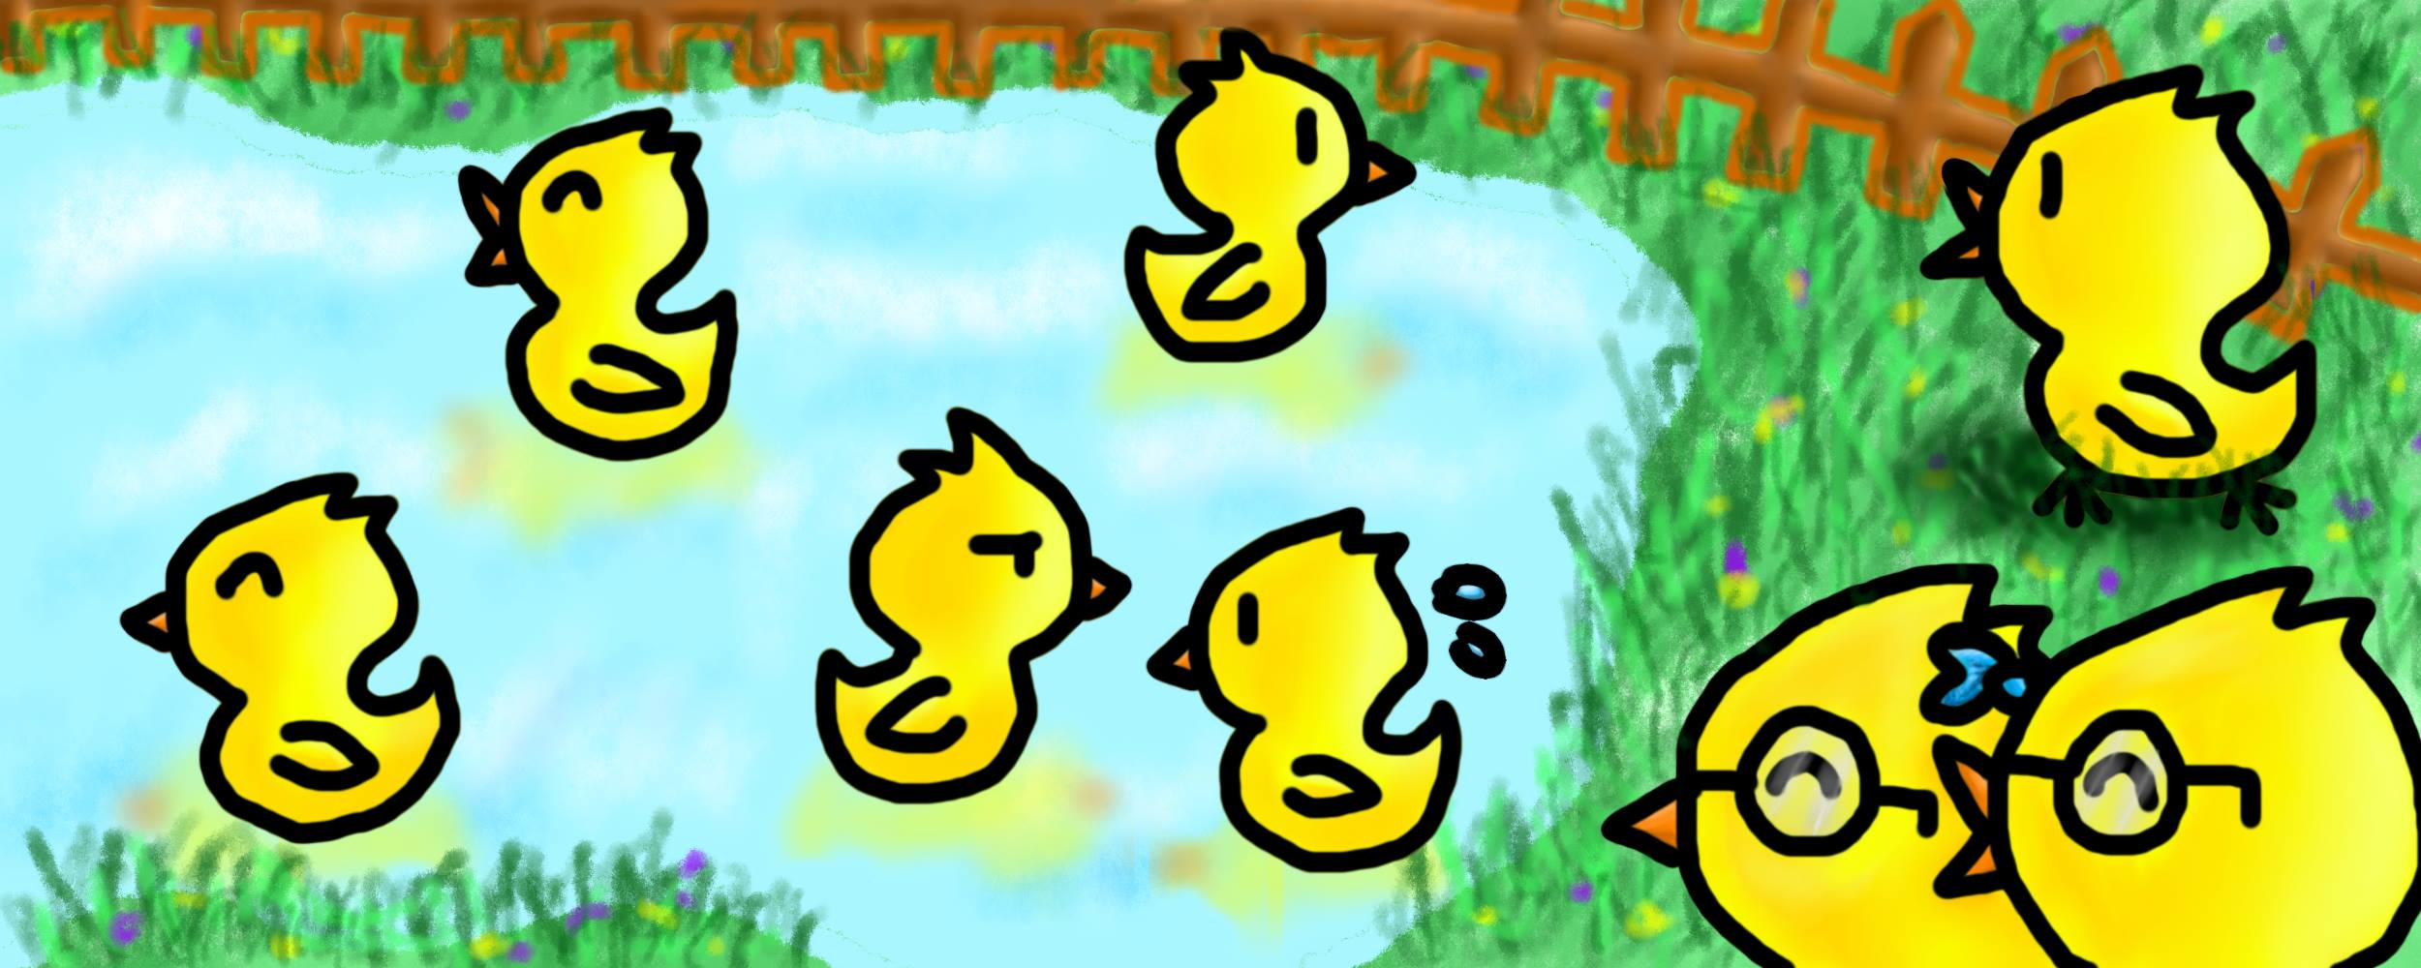
Motivation

Slide 3
Tools
SFML
Adobe Photoshop

Slide 4
Assets

Slide 5
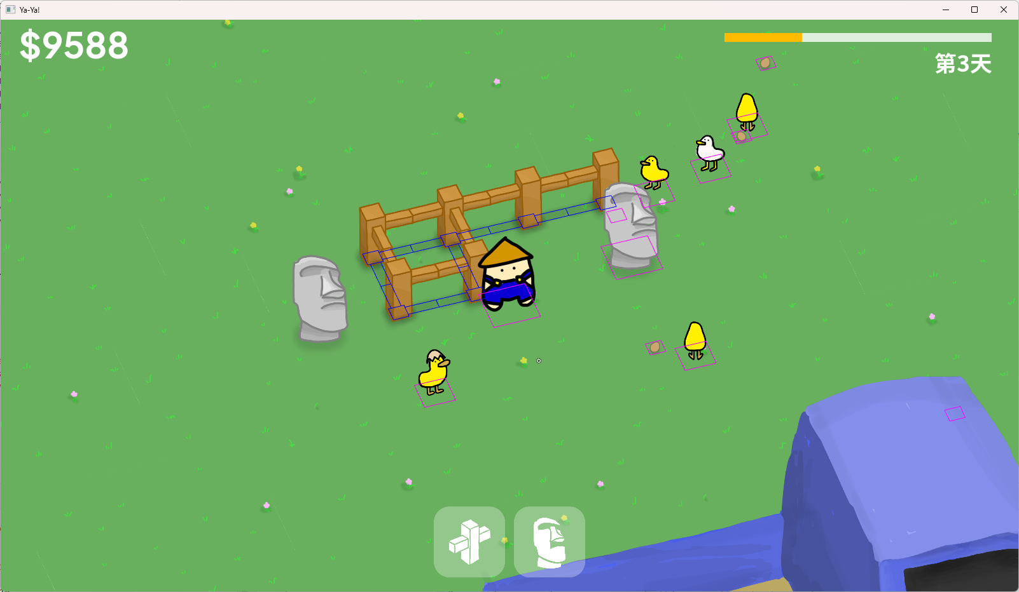
Game Mechanics
Picking Up Items
Selling Ducks & Eggs
Making Money
Building Things

Slide 6
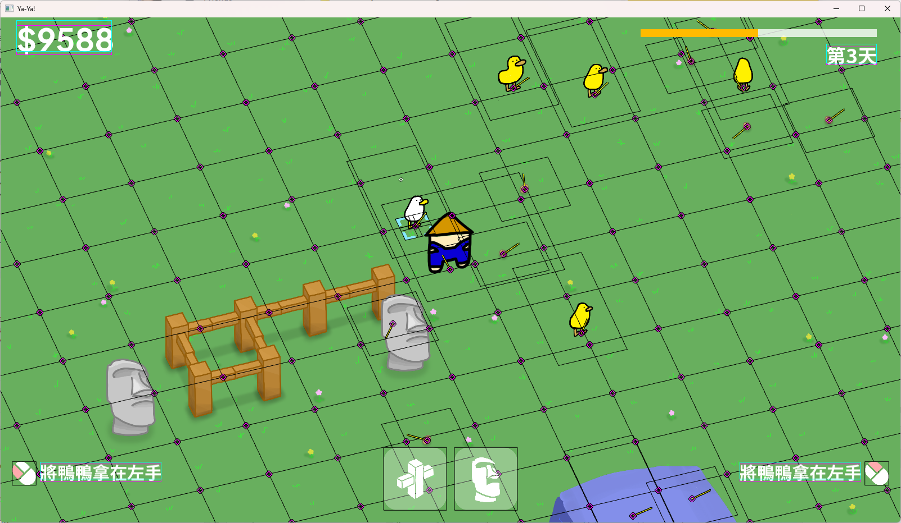
Important Classes
Game / Entity / Player / Duck…
UserInterface / Graphics / Camera
Map / Chunk / Tile
Action
Serialization
Game Controller

Slide 7
Demo Time

Slide 8
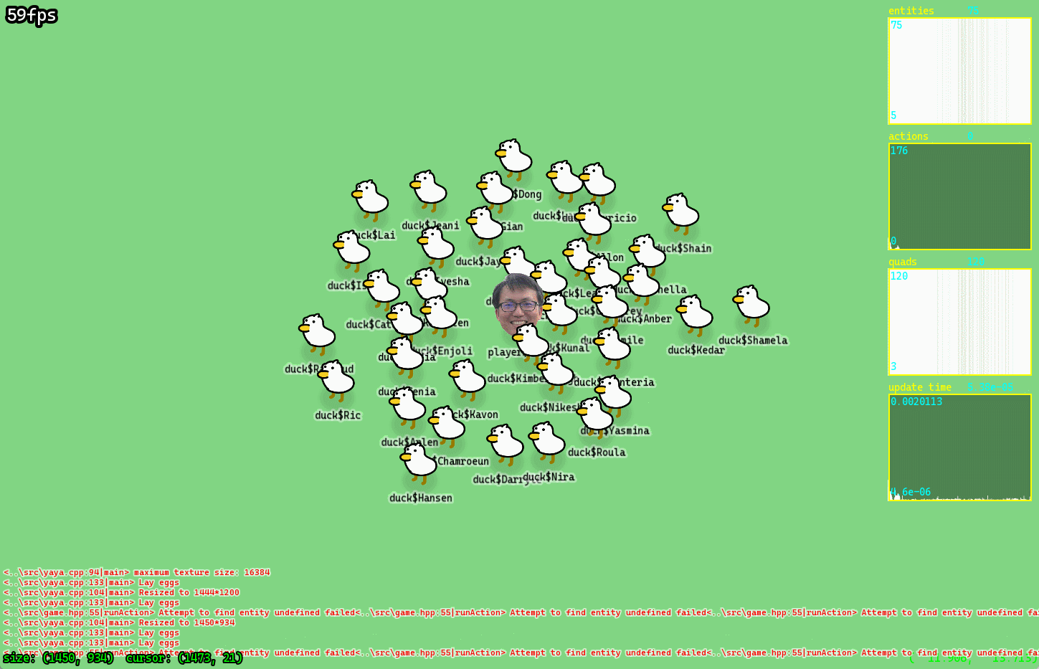
Expected Future Improvement
Gameplay
UI
Several Collision Bugs
Serialization

